Slide 1
Lab 9 Sets Ops, Where Clause Subqueries
United International College
COMP3013 DBMS

Slide 2
Outline
Set Operations
Union
Intersection
Set difference
Subquery
IN subquery
NOT IN subquery

Slide 3
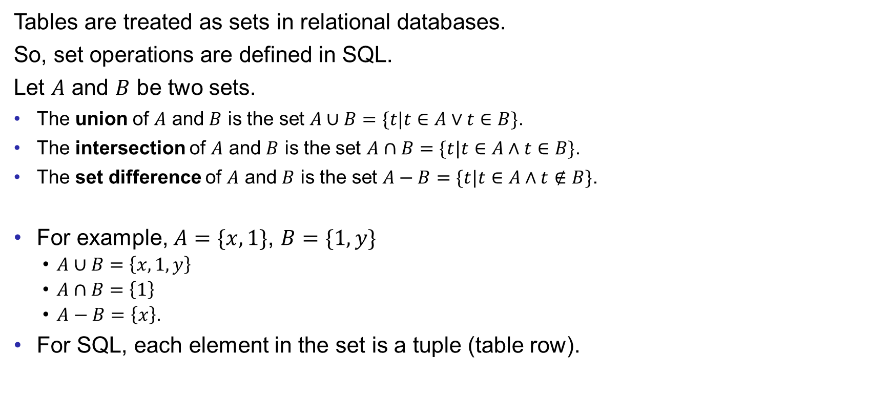
Set Operations
Tables are treated as sets in relational databases.
So, set operations are defined in SQL.
Let $A$ and $B$ be two sets.
The union of $A$ and $B$ is the set $A∪B=\{t|t∈A∨t∈B\}$.
The intersection of $A$ and $B$ is the set $A∩B=\{t|t∈A∧t∈B\}$.
The set difference of $A$ and $B$ is the set $A−B=\{t|t∈A∧t∉B\}$.
For example, $A=\{x,1\}$, $B=\{1,y\}$
$A∪B=\left\{x,1,y\right\}$
$A∩B=\left\{1\right\}$
$A−B=\left\{x\right\}$.
For SQL, each element in the set is a tuple (table row).

Slide 4
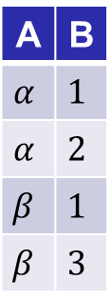

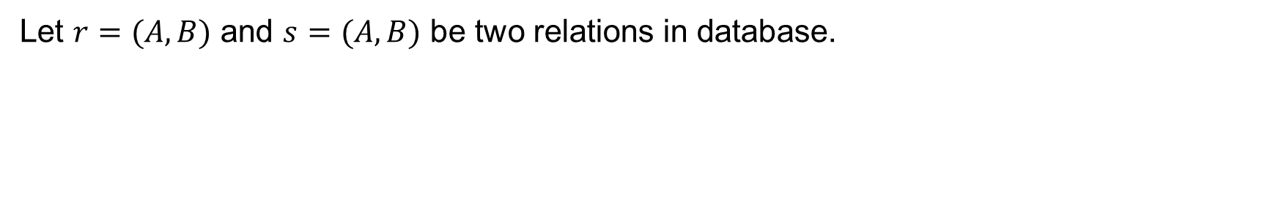

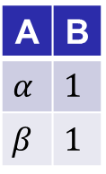


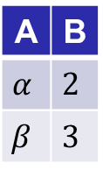
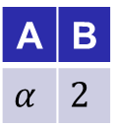
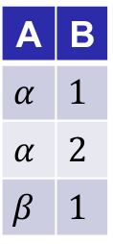

Set Operations
Let $r=(A,B)$ and $s=(A,B)$ be two relations in database.
$$r$$
A | B
$$α$$ | $$1$$
$$α$$ | $$2$$
$$β$$ | $$1$$
$$s$$
A | B
$$α$$ | $$2$$
$$β$$ | $$3$$
Note:
Duplicated rows are removed in this example (because sets do not have duplications).
But, MySQL keeps duplications.
$$r∪s$$
A | B
$$α$$ | $$1$$
$$α$$ | $$2$$
$$β$$ | $$1$$
$$β$$ | $$3$$
$$r∩s$$
A | B
$$α$$ | $$2$$
$$r−s$$
A | B
$$α$$ | $$1$$
$$β$$ | $$1$$

Slide 5
Union
Find the title of films which is played by “Bob” or “Zero” (first names of actors).
Select the films played by Bob
Select the films played by Zero
Union the two tables
(SELECT title, first_name
FROM actor JOIN film_actor USING (actor_id) JOIN film USING (film_id) WHERE first_name='Bob')
UNION
(SELECT title, first_name
FROM actor JOIN film_actor USING (actor_id) JOIN film USING (film_id) WHERE first_name='Zero')

Slide 6
Union
Please be careful when UNION is used.
The two tables of the union must be compatible: corresponding columns must be of the same type.
To check the type of columns, click “structure” tag for each table.
Types are formally introduced in the following lab.
MySQL is very robust. It allows union between different types.
For example,
(SELECT actor_id FROM actor) UNION (SELECT first_name FROM actor)
However, this is NOT the reason for a union without type checking.

Slide 7
Intersection
For table intersection use the keyword INTERSECT.
Find the id of the English films which are played by Tim Hackman.
(SELECT film_id
FROM film_actor JOIN actor USING(actor_id)
WHERE first_name='Tim' AND last_name='Hackman')
INTERSECT
(SELECT film_id
FROM film JOIN language USING(language_id)
WHERE name='English')
Previous versions of MySQL doesn’t support INTERSECT. In that case, we can use IN subquery instead. We will learn that later in this lab.

Slide 8
Set Difference
For set difference use the keyword EXCEPT.
Find the id of the films which are played by Tim Hackman but not in English.
(SELECT film_id
FROM film_actor JOIN actor USING(actor_id)
WHERE first_name='Tim' AND last_name='Hackman’)
EXCEPT
(SELECT film_id
FROM film JOIN language USING(language_id)
WHERE name='English')
Previous versions of MySQL doesn’t support INTERSECT. In that case, we can use NOT IN subquery instead. We will learn that later in this lab.

Slide 9
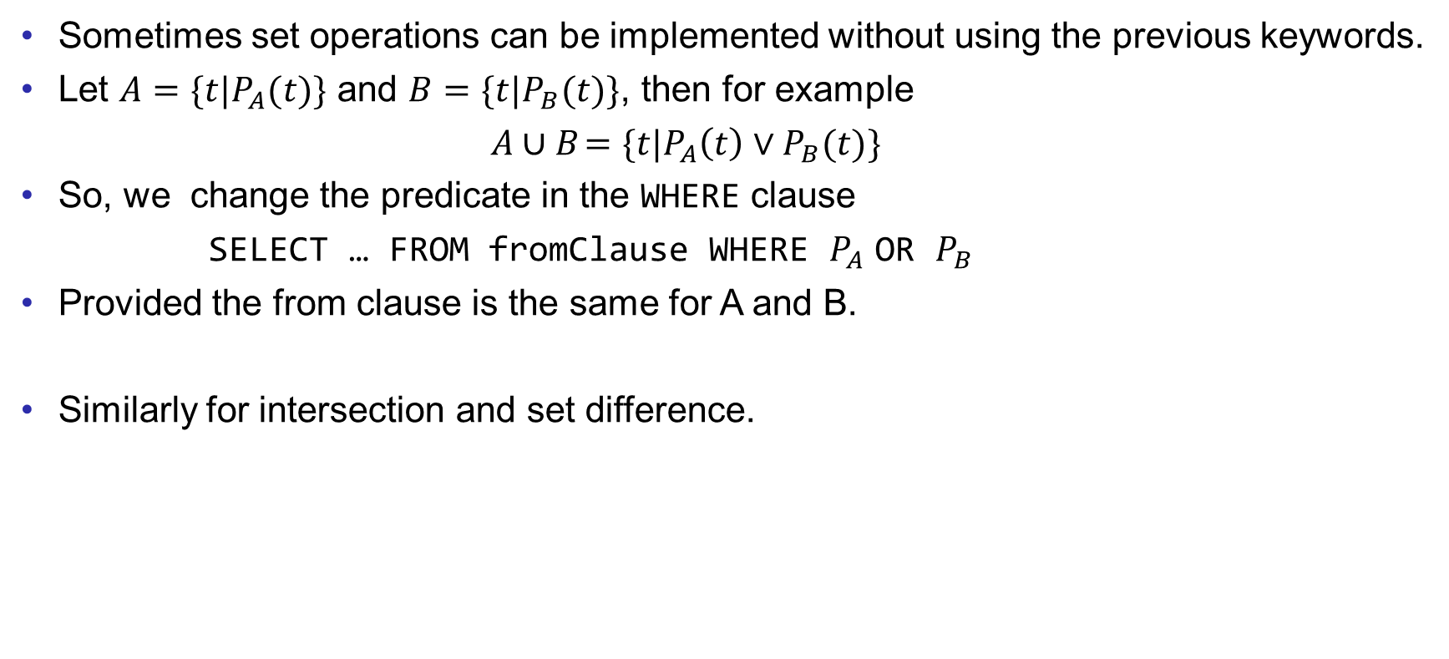
Set Operations
Sometimes set operations can be implemented without using the previous keywords.
Let $A=\{t|P_{A}(t)\}$ and $B=\{t|P_{B}(t)\}$, then for example
$A∪B$ $=\{t|P_{A}\left(t\right)∨P_{B}(t)\}$
So, we change the predicate in the WHERE clause
SELECT … FROM fromClause WHERE $P_{A}$ OR $P_{B}$
Provided the from clause is the same for A and B.
Similarly for intersection and set difference.

Slide 10

Subquery
Subqueries can also be used to test the membership of one tuple (element) in one table (set).
We can use the IN subquery for intersection and NOT IN subquery for set difference.
The intersection $A∩B$ is defined as $∀x, x∈A∧x∈B$.
Which is equivalent to $∀x∈A,x∈B$ (by changing the domain of $x$).

Slide 11
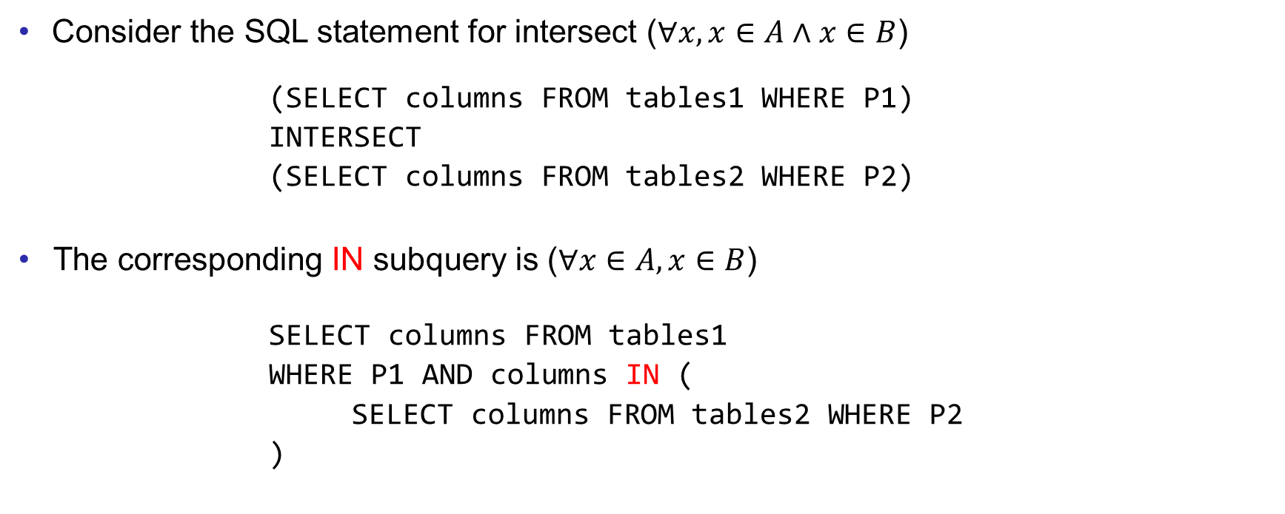
IN Subquery for INTERSECTION
Consider the SQL statement for intersect ($∀x,x∈A∧x∈B$)
(SELECT columns FROM tables1 WHERE P1)
INTERSECT
(SELECT columns FROM tables2 WHERE P2)
The corresponding IN subquery is ($∀x∈A,x∈B$)
SELECT columns FROM tables1
WHERE P1 AND columns IN (
SELECT columns FROM tables2 WHERE P2
)

Slide 12
Intersection Example
Find the id of the English films which are played by Tim Hackman.
We can use INTERSECT in the latest version of MySQL.
(SELECT film_id
FROM film JOIN language USING(language_id)
WHERE name='English')
INTERSECT
(SELECT film_id
FROM film_actor JOIN actor USING(actor_id)
WHERE first_name='Tim' AND last_name='Hackman')
As an alternative to INTERSET, we can make the second SELECT into a subquery.

Slide 13
Intersection Example
Using IN subquery instead of INTERSECTION
SELECT film_id
FROM film JOIN language USING(language_id)
WHERE name = 'English' AND
film_id IN (
SELECT film_id
FROM film_actor JOIN actor USING(actor_id)
WHERE first_name='Tim' AND last_name='Hackman'
)
The subquery constructs a temporary table of ids of the films played by Tim Hackman.
The keyword IN tests whether the value of film id for each tuple is in the temporary table.

Slide 14
SOME
The previous example can also be implemented by using SOME.
If an element is in a set, then the element is equal to some element in the set.
SELECT film_id
FROM film JOIN language USING(language_id)
WHERE name = 'English' AND
film_id = SOME(
SELECT film_id
FROM film_actor JOIN actor USING(actor_id)
WHERE first_name='Tim' AND last_name='Hackman'
)

Slide 15
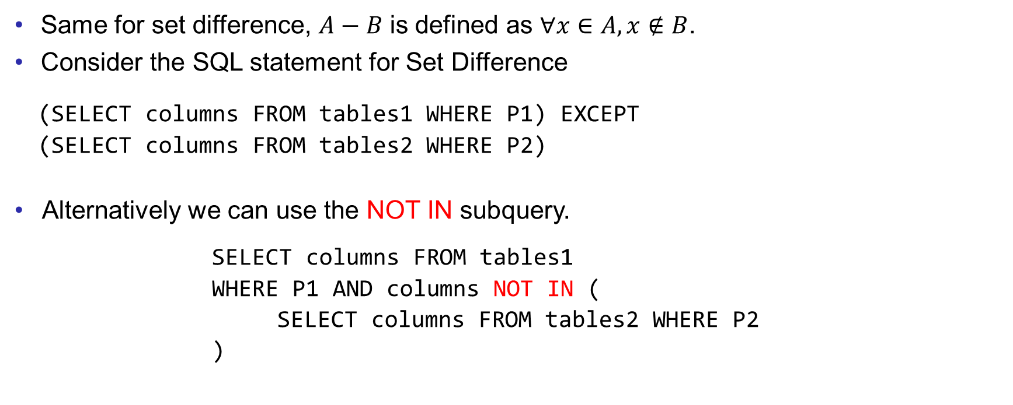
NOT IN Subquery for EXCEPT (Set Difference)
Same for set difference, $A−B$ is defined as $∀x∈A,x∉B$.
Consider the SQL statement for Set Difference
(SELECT columns FROM tables1 WHERE P1) EXCEPT
(SELECT columns FROM tables2 WHERE P2)
Alternatively we can use the NOT IN subquery.
SELECT columns FROM tables1
WHERE P1 AND columns NOT IN (
SELECT columns FROM tables2 WHERE P2
)

Slide 16
Set Difference Example
Find the id of the films which are played by Tim Hackman that are not in English.
In the latest version of MySQL, we can use EXCEPT.
(SELECT film_id
FROM film_actor JOIN actor USING(actor_id)
WHERE first_name='Tim' AND last_name='Hackman')
EXCEPT
(SELECT film_id
FROM film JOIN language USING(language_id)
WHERE name='English')

Slide 17
Set Difference Example
We can use NOT IN subquery instead of EXCEPT
SELECT film_id
FROM film_actor JOIN actor USING(actor_id)
WHERE first_name='Tim' AND last_name='Hackman' AND
film_id NOT IN (
SELECT film_id
FROM film JOIN language USING(language_id)
WHERE name='English')
The subquery constructs a temporary table of ids of films in English.
The keyword NOT IN tests whether the value of film id for each tuple is not in the temporary table, i.e. not in English.

Slide 18
Exercises
Write MySQL queries for the following:
In the Example (pg. 5) of Set Operation for UNION, rewrite the query with set operation without the keyword UNION.
In the Example for Intersect, “Find the id of the English films which are played by Tim Hackman”, the query result only show the film_id. Rewrite the query to display the language as well in the result.
In the Example for Set Difference, “Find the id of the films which are played by Tim Hackman that are not in English”, the result seems to be empty. Verify this by writing a query to display the film_id and language of all films played by Tim Hackman.
Find the id of the customers who live in Australia that have not rented any film.
Save your queries in a txt file. Rename it as “COMP3013 Lab9 ###.txt”, where “###” is your student ID. And submit it on iSpace. The DDL is 24 hours after the lab.

Slide 19
End of Lab 9

